Slide 1
Chapter 8
How to handle exceptions

Slide 2
Applied objectives
Add the proper level of exception handling to your programs.
Use raise statements to test the exception handling in your programs.

Slide 3
Knowledge objectives
Describe the types of exceptions that need to be handled by a program.
Describe the operation of a try statement with one or more except clauses.
Describe the use of an exception object in your exception handling routines.
Describe the use of the exit() function in the sys module.
Describe the use of a finally clause in a try statement.
Explain why you may need to raise exceptions when testing your exception handling routines.

Slide 4
Code that can cause a ValueError exception
number = int(input("Enter an integer: "))
print("You entered a valid integer of " + str(number) + ".")
print("Thanks!")
The console for a valid integer
Enter an integer: 5
You entered a valid integer of 5.
Thanks!
The console for an invalid integer
Enter an integer: five
Traceback (most recent call last):
File "C:\murach\python\book_figs\ch07\fig1.py", line 1, in <module>
number = int(input("Enter a valid integer: "))
ValueError: invalid literal for int() with base 10: 'five'

Slide 5
Two functions that can cause a ValueError exception
Function Reason for exception
int(data) Can’t convert the data argument to an int value.
float(data) Can’t convert the data argument to a float value.

Slide 6
The syntax for a try statement that catches an exception
try:
statements
except [ExceptionName]:
statements

Slide 7
How to handle a ValueError exception
try:
number = int(input("Enter an integer: "))
print("You entered a valid integer of " + str(number) + ".")
except ValueError:
print("You entered an invalid integer. Please try again.")
print("Thanks!")
The console for a valid integer
Enter an integer: 5
You entered a valid integer of 5.
Thanks!
The console for an invalid integer
Enter an integer: five
You entered an invalid integer. Please try again.
Thanks!
Notes:
try:
number = int(input("Enter an integer: "))
print("You entered a valid integer of " + str(number) + ".")
except ValueError:
print("You entered an invalid integer. Please try again.")
print("Thanks!")

Slide 8
How to handle all exceptions Please tell me what is the difference of this and the previous one… I could not find!
try:
number = int(input("Enter an integer: "))
print("You entered a valid integer of " + str(number) + ".")
except:
print("You entered an invalid integer. Please try again.")
print("Thanks!")

Slide 9
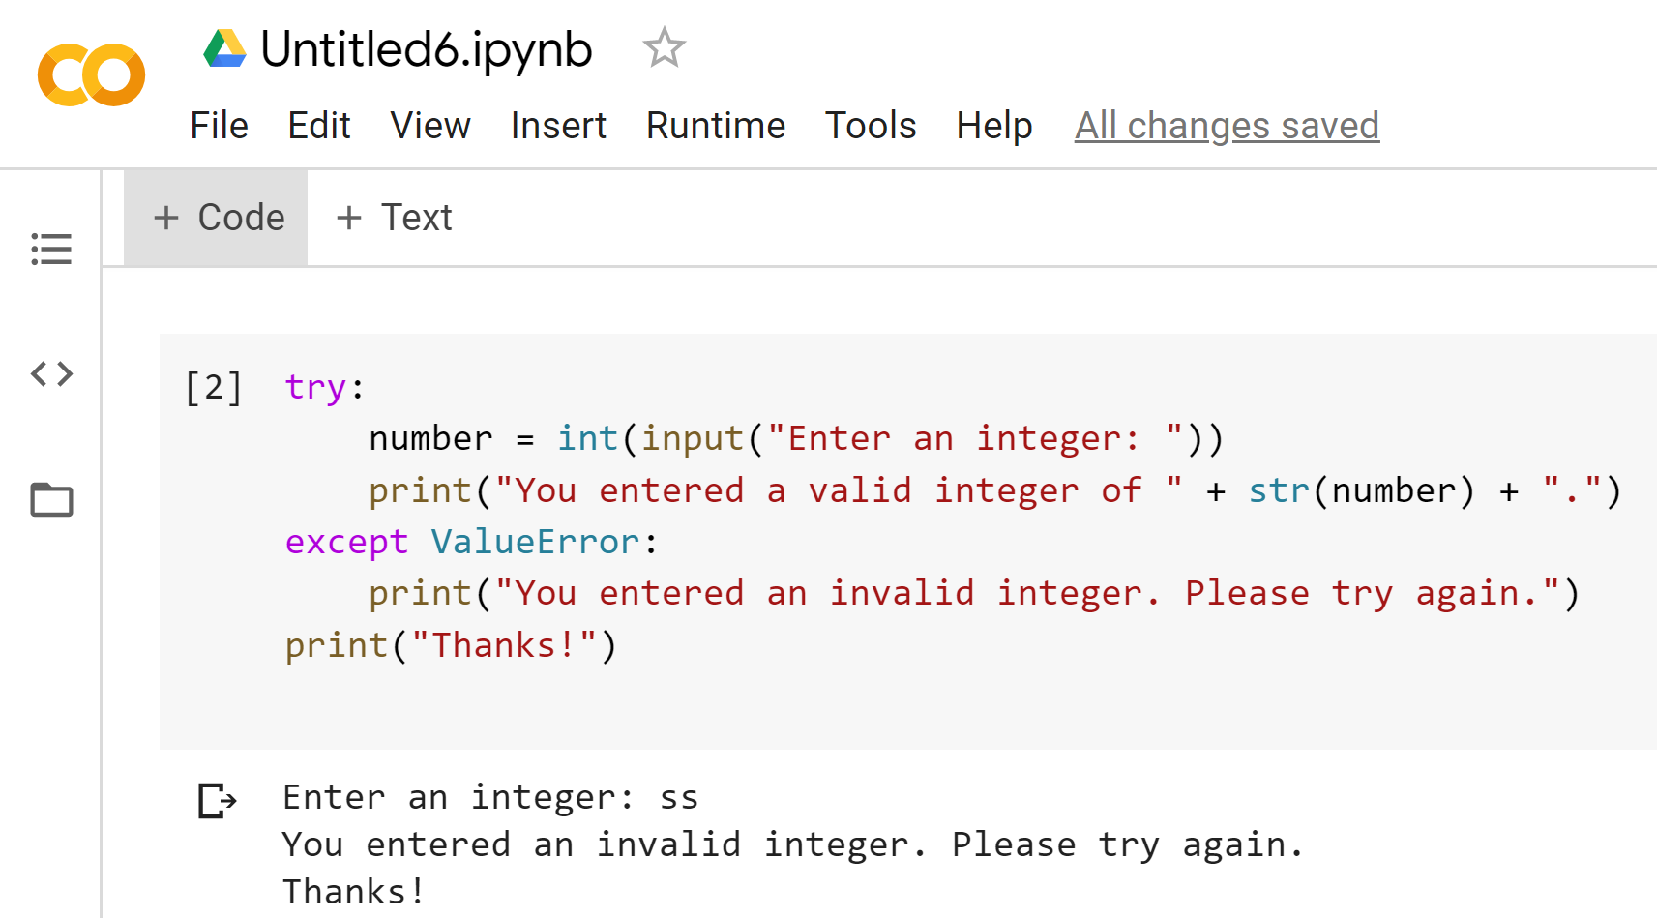
How to handle all exceptions
Notes:
try:
number = int(input("Enter an integer: "))
print("You entered a valid integer of " + str(number) + ".")
except ValueError:
print("You entered an invalid integer. Please try again.")
print("Thanks!")

Slide 10
The user interface for the Total Calculator program
The Total Calculator program
Enter price: ten
Invalid decimal number. Please try again.
Enter price: 9.99
Enter quantity: 2.5
Invalid integer. Please try again.
Enter quantity: 3
PRICE: 9.99
QUANTITY: 3
TOTAL: 29.97

Slide 11
The code for the Total Calculator program (part 1)
def get_price():
while True:
try:
price = float(input("Enter price: "))
return price
except ValueError:
print("Invalid decimal number. Please try again.")
def get_quantity():
while True:
try:
quantity = int(input("Enter quantity: "))
return quantity
except ValueError:
print("Invalid integer. Please try again.")

Slide 12
The code for the Total Calculator program (part 2)
def main():
print("The Total Calculator program\n")
# get the price and quantity
price = get_price()
quantity = get_quantity()
# calculate the total
total = price * quantity
# display the results
print()
print("PRICE: ", price)
print("QUANTITY: ", quantity)
print("TOTAL: ", total)
if __name__ == "__main__":
main()

Slide 13
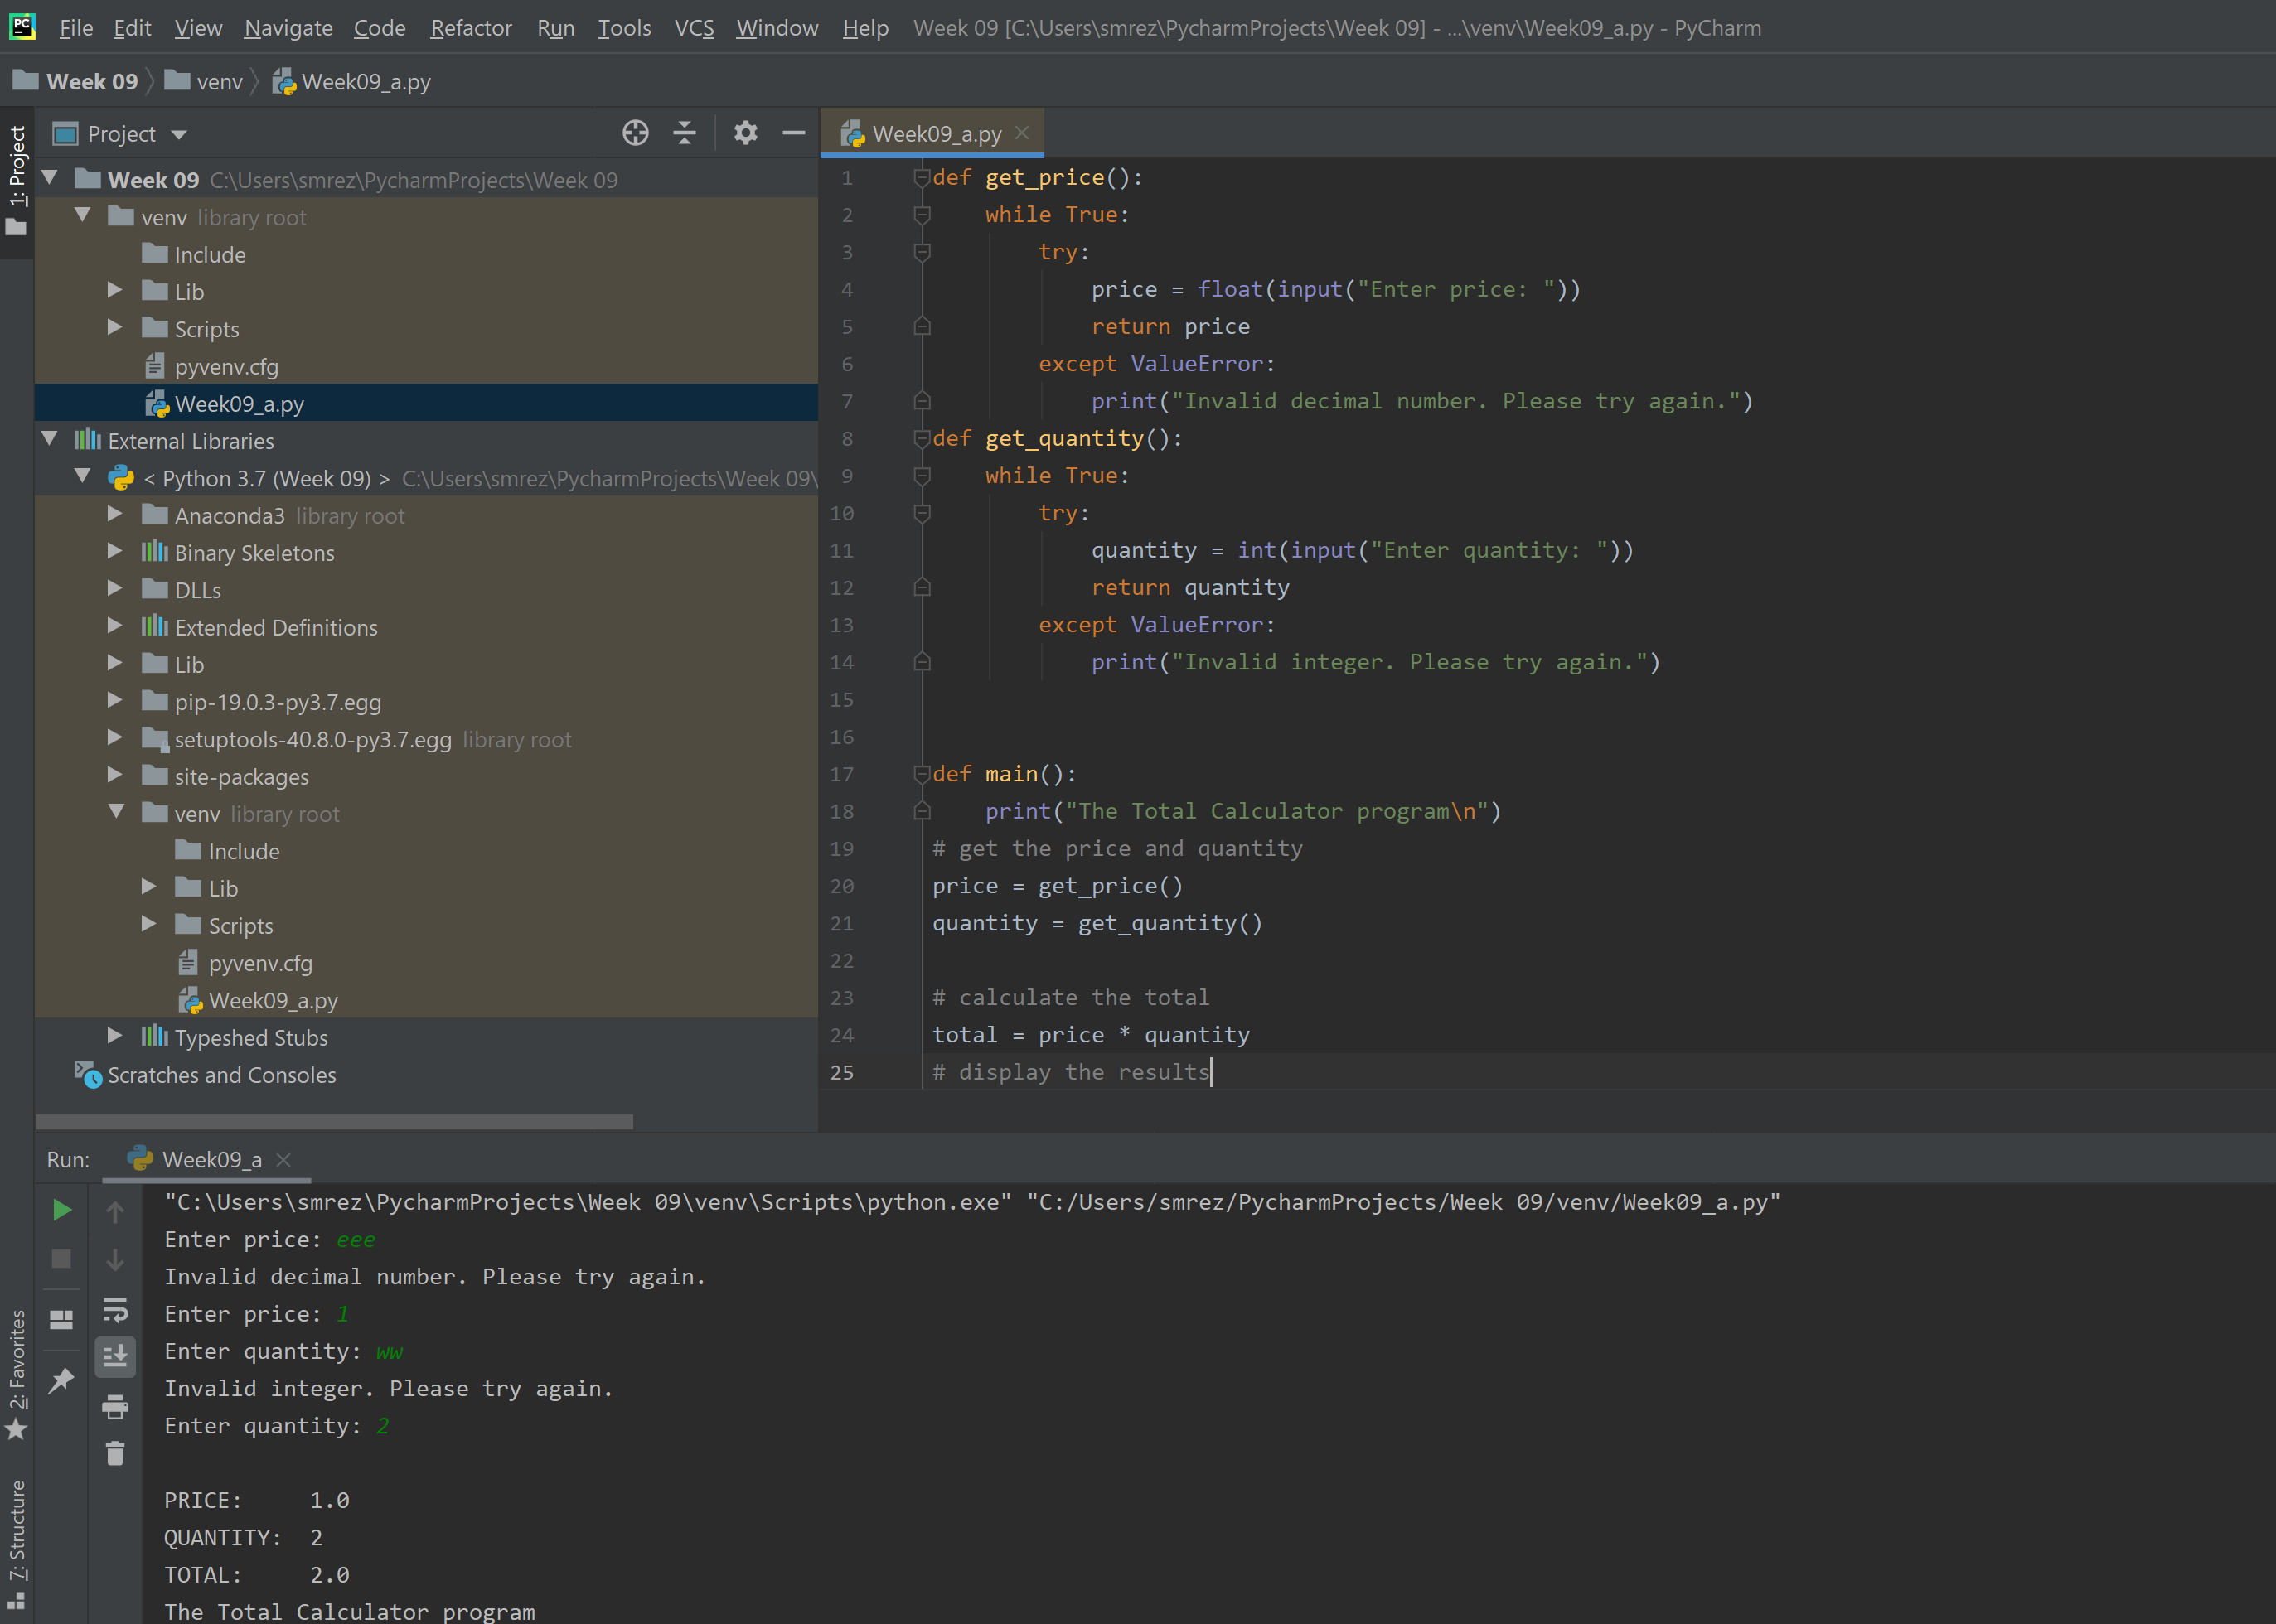
The code for the Total Calculator program (Full)
Notes:
def get_price(): while True: try: price = float(input("Enter price: ")) return price except ValueError: print("Invalid decimal number. Please try again.") def get_quantity(): while True: try: quantity = int(input("Enter quantity: ")) return quantity except ValueError: print("Invalid integer. Please try again.") def main(): print("The Total Calculator program\n") # get the price and quantity price = get_price() quantity = get_quantity() # calculate the total total = price * quantity # display the results print() print("PRICE: ", price) print("QUANTITY: ", quantity) print("TOTAL: ", total) if __name__ == "__main__": main()

Slide 14
The hierarchy for five common exceptions
Exception
OSError
FileExistsError
FileNotFoundError
ValueError

Slide 15
The syntax for a try statement with multiple except blocks
try:
statements
except ExceptionName:
statements
[except ExceptionName:
statements] ...

Slide 16
Code that handles multiple exceptions
filename = input("Enter filename: ")
movies = []
try:
with open(filename) as file:
for line in file:
line = line.replace("\n", "")
movies.append(line)
except FileNotFoundError:
print("Could not find the file named " + filename)
except OSError:
print("File found - error reading file")
except Exception:
print("An unexpected error occurred")
The console when a FileNotFoundError occurs
Could not find the file named films.txt
The console when an OSError occurs
File found – error reading file
The console when any other Exception occurs
An unexpected error occurred.

Slide 17
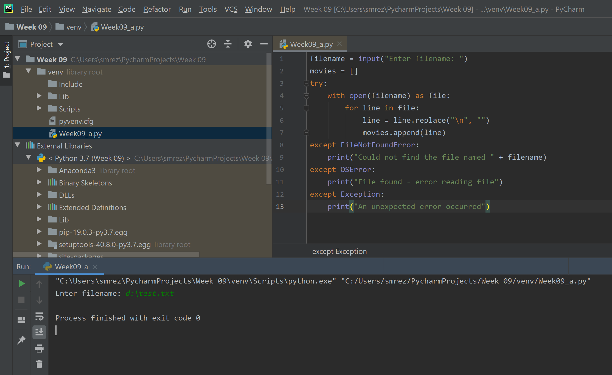
Code that handles multiple exceptions
Notes:
filename = input("Enter filename: ") movies = [] try: with open(filename) as file: for line in file: line = line.replace("\n", "") movies.append(line) except FileNotFoundError: print("Could not find the file named " + filename) except OSError: print("File found - error reading file") except Exception: print("An unexpected error occurred")

Slide 18
The built-in type() function
type(object)
The exit() function of the sys module
exit()

Slide 19
The complete syntax for the except clause
except [ExceptionName] [as name]:
statements
Code that handles multiple exceptions
import sys
filename = input("Enter filename: ")
movies = []
try:
with open(filename) as file:
for line in file:
line = line.replace("\n", "")
movies.append(line)
except FileNotFoundError as e:
print("FileNotFoundError:", e)
sys.exit()
except OSError as e:
print("OSError:", e)
sys.exit()
except Exception as e:
print(type(e), e)
sys.exit()

Slide 20
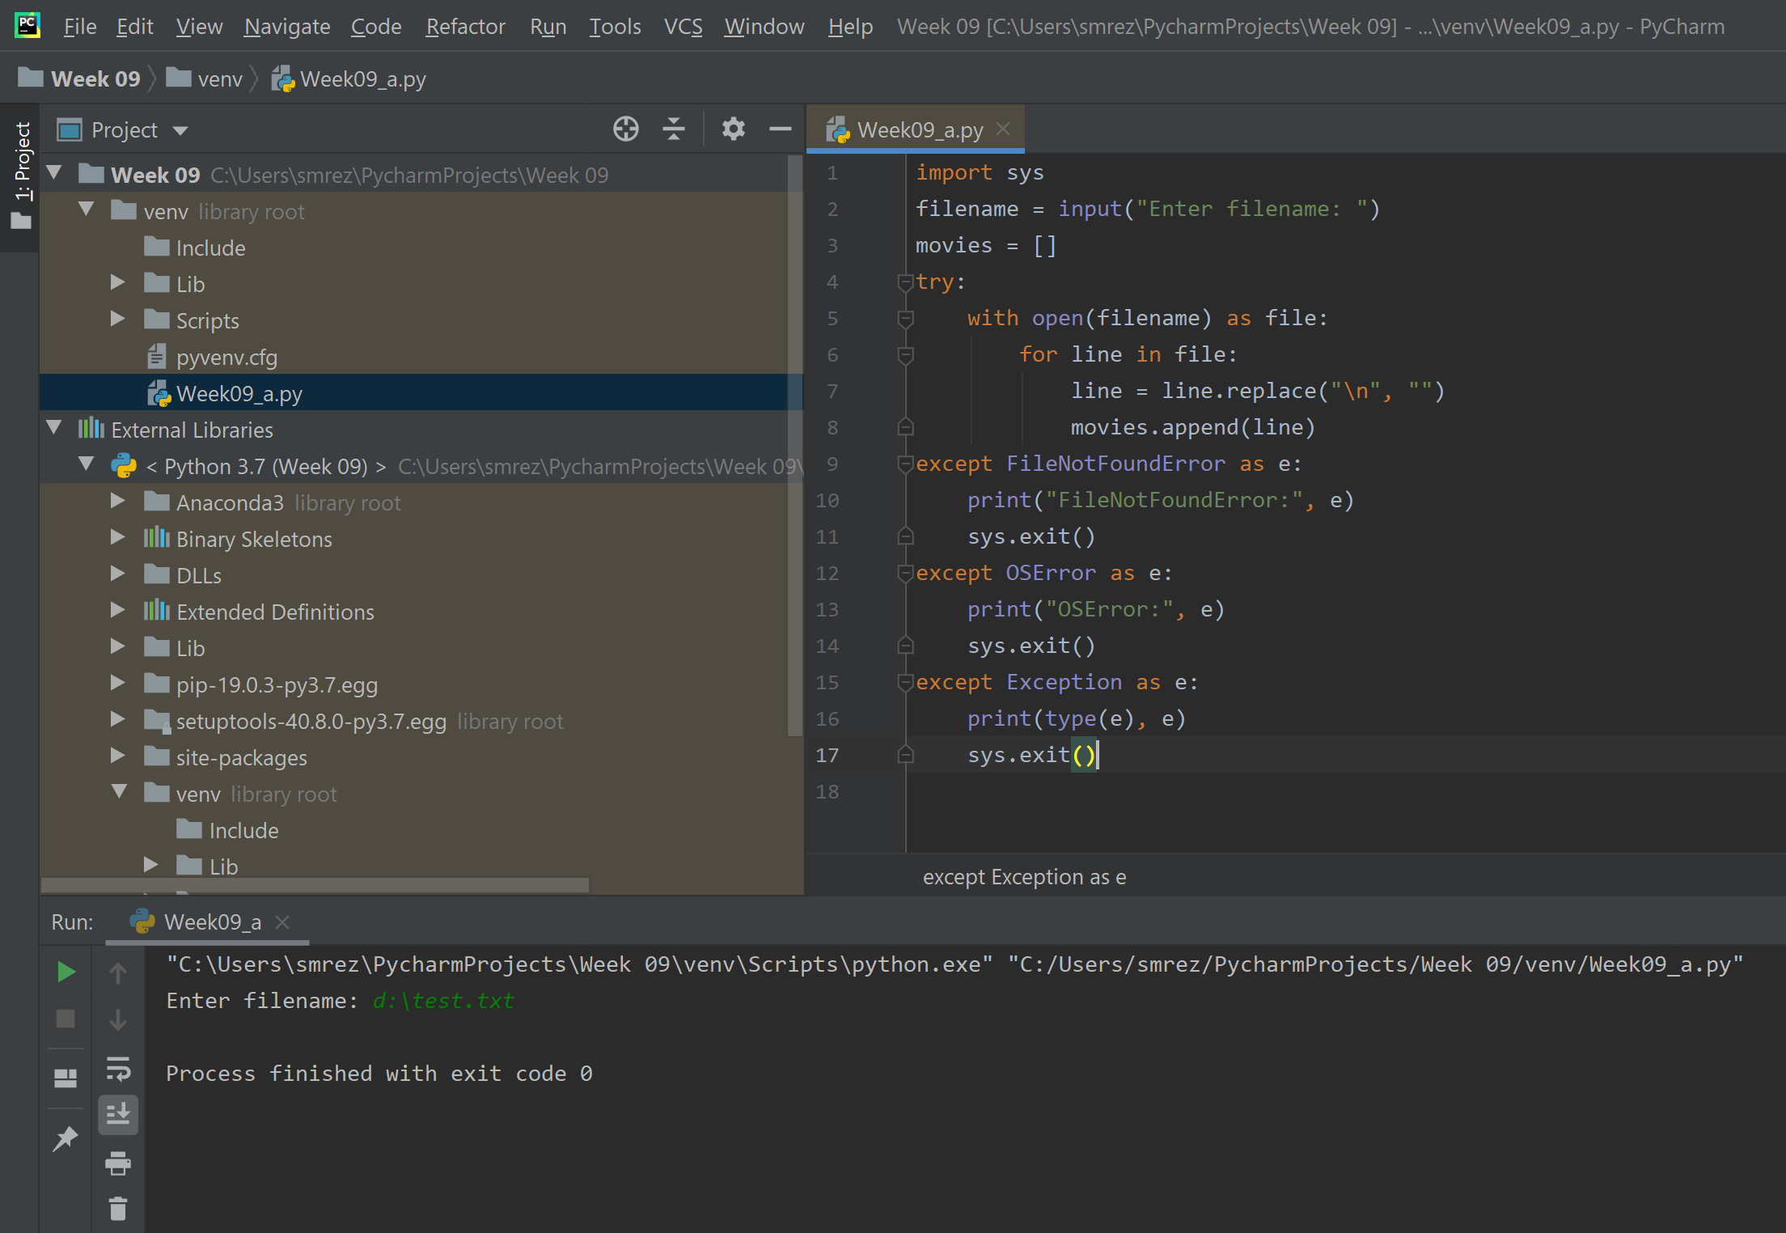
The complete syntax for the except clause
Notes:
import sys filename = input("Enter filename: ") movies = [] try: with open(filename) as file: for line in file: line = line.replace("\n", "") movies.append(line) except FileNotFoundError as e: print("FileNotFoundError:", e) sys.exit() except OSError as e: print("OSError:", e) sys.exit() except Exception as e: print(type(e), e) sys.exit()

Slide 21
The console when a FileNotFoundError occurs
FileNotFoundError: [Errno 2] No such file or directory: 'films'
The console when an OSError occurs
OSError: [Errno 13] Permission denied: 'movies.csv'

Slide 22
The user interface for the Movie List 2.0 program with exception handling
COMMAND MENU
list - List all movies
add - Add a movie
del - Delete a movie
exit - Exit program
Command: list
1. Monty Python and the Holy Grail (1975)
2. Cat on a Hot Tin Roof (1958)
3. On the Waterfront (1954)
4. Gone with the Wind (1939)
5. Wizard of Oz (1939)
Command: del
Number: x
Invalid integer. Please try again.
Number: 6
There is no movie with that number. Please try again.
Number: 4
Gone with the Wind was deleted.

Slide 23
A console that handles a file I/O exception
COMMAND MENU
list - List all movies
add - Add a movie
del - Delete a movie
exit - Exit program
Could not find movies.csv file.
Terminating program.

Slide 24
The code for the Movie List 2.0 program (part 1)
import csv
import sys
FILENAME = “movies.csv"
def read_movies():
try:
movies = []
with open(FILENAME, newline="") as file:
reader = csv.reader(file)
for row in reader:
movies.append(row)
return movies
except FileNotFoundError:
print("Could not find " + FILENAME + " file.")
exit_program()
except Exception as e:
print(type(e), e)
exit_program()

Slide 25
The code for the Movie List 2.0 program (part 2)
def write_movies(movies):
try:
with open(FILENAME, "w", newline="") as file:
writer = csv.writer(file)
writer.writerows(movies)
except Exception as e:
print(type(e), e)
exit_program()
def exit_program():
print("Terminating program.")
sys.exit()

Slide 26
The code for the Movie List 2.0 program (part 3)
def delete_movie(movies):
while True:
try:
number = int(input("Number: "))
except ValueError:
print("Invalid integer. Please try again.")
continue
if number < 1 or number > len(movies):
print("There is no movie with that number. " +
"Please try again.")
else:
break
movie = movies.pop(number - 1)
write_movies(movies)
print(movie[0] + " was deleted.\n")

Slide 27
The code for the Movie List 2.0 program (part 4)
def main():
display_menu()
movies = read_movies()
while True:
command = input("Command: ")
if command == "list":
list_movies(movies)
elif command == "add":
add_movie(movies)
elif command == "del":
delete_movie(movies)
elif command == "exit":
break
else:
print("Not a valid command. Please try again.\n")
print("Bye!")

Slide 28
The complete syntax for a try statement
try:
statements
except [ExceptionName] [as name]:
statements
[except [ExceptionName] [as name]:
statements] ...
[finally:
statements]

Slide 29
A function that uses a with statement to clean up resources
def read_movies(filename):
try:
with open(filename, newline="") as file:
movies = []
reader = csv.reader(file)
for row in reader:
movies.append(row)
return movies
except Exception as e:
print(e)

Slide 30
A function that uses a finally clause to clean up resources
def read_movies(filename):
try:
file = open(filename, newline="")
try:
movies = []
reader = csv.reader(file)
for row in reader:
movies.append(row)
return movies
except Exception as e:
print(type(e), e)
finally:
file.close()
except FileNotFoundError as e:
print(e)

Slide 31
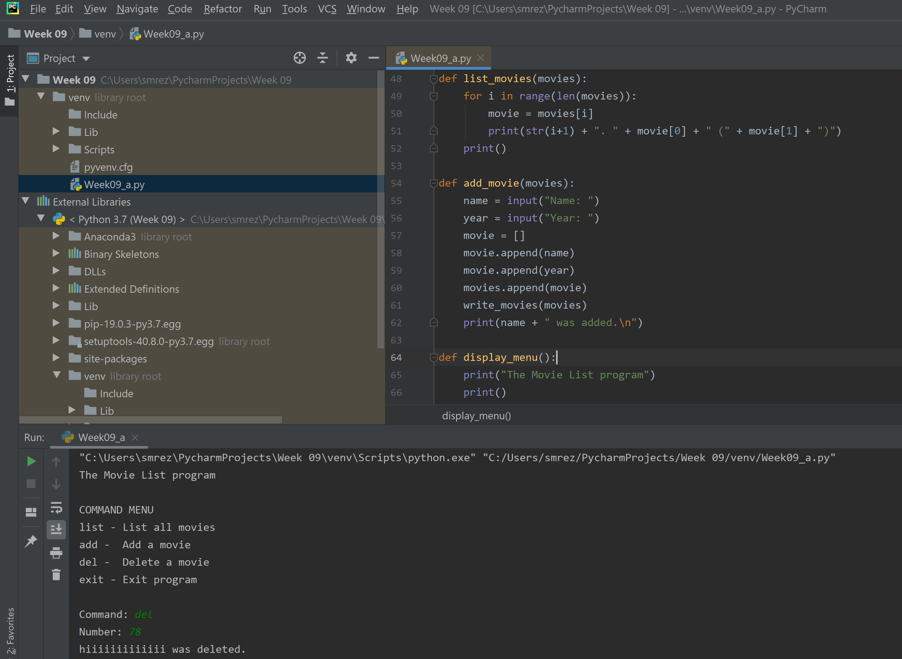
A function that uses a finally clause to clean up resources
Notes:
import csv import sys FILENAME = "d:\movies.csv" def read_movies(): try: movies = [] with open(FILENAME, newline="") as file: reader = csv.reader(file) for row in reader: movies.append(row) return movies except FileNotFoundError: print("Could not find " + FILENAME + " file.") exit_program() except Exception as e: print(type(e), e) exit_program() def write_movies(movies): try: with open(FILENAME, "w", newline="") as file: writer = csv.writer(file) writer.writerows(movies) except Exception as e: print(type(e), e) exit_program() def exit_program(): print("Terminating program.") sys.exit() def delete_movie(movies): while True: try: number = int(input("Number: ")) except ValueError: print("Invalid integer. Please try again.") continue if number < 1 or number > len(movies): print("There is no movie with that number. " + "Please try again.") else: break movie = movies.pop(number - 1) write_movies(movies) print(movie[0] + " was deleted.\n") def list_movies(movies): for i in range(len(movies)): movie = movies[i] print(str(i+1) + ". " + movie[0] + " (" + movie[1] + ")") print() def add_movie(movies): name = input("Name: ") year = input("Year: ") movie = [] movie.append(name) movie.append(year) movies.append(movie) write_movies(movies) print(name + " was added.\n") def display_menu(): print("The Movie List program") print() print("COMMAND MENU") print("list - List all movies") print("add - Add a movie") print("del - Delete a movie") print("exit - Exit program\n") def main(): display_menu() movies = read_movies() while True: command = input("Command: ") if command == "list": list_movies(movies) elif command == "add": add_movie(movies) elif command == "del": delete_movie(movies) elif command == "exit": break else: print("Not a valid command. Please try again.\n") print("Bye!") if __name__ == "__main__": main()

Slide 32
The syntax for the raise statement
raise ExceptionName("Error message")
Raising a ValueError exception
raise ValueError("Invalid value")

Slide 33
Raising an exception for testing an exception handler
def get_movies(filename):
try:
with open(filename, newline="") as file:
raise OSError("OSError") # for testing
movies = []
reader = csv.reader(file)
for row in reader:
movies.append(row)
return movies
except Exception as e:
print(type(e), e)

Slide 34
Raising an exception that should be handled by the calling function
def get_movies(filename):
if len(filename) == 0:
raise ValueError("The filename argument is required.")
with open(filename, newline="") as file:
movies = []
reader = csv.reader(file)
for row in reader:
movies.append(row)
return movies
Notes:
import csv import sys def get_movies(filename): try: with open(filename, newline="") as file: raise OSError("OSError") # for testing movies = [] reader = csv.reader(file) for row in reader: movies.append(row) return movies except Exception as e: print(type(e), e) # def get_movies(filename): # if len(filename) == 0: # raise ValueError("The filename argument is required.") # with open(filename, newline="") as file: # movies = [] # reader = csv.reader(file) # for row in reader: # movies.append(row) # return movies get_movies("d:\movies.csv")

Slide 35
Logging an exception and raising it for the calling function
def get_movies(filename):
try:
with open(filename, newline="") as file:
movies = []
reader = csv.reader(file)
for row in reader:
movies.append(row)
return movies
except Exception as e:
log_exception(e)
raise e
Notes:
Import logging
logging.exception("Exception occurred")
https://realpython.com/python-logging/

